Slide 1
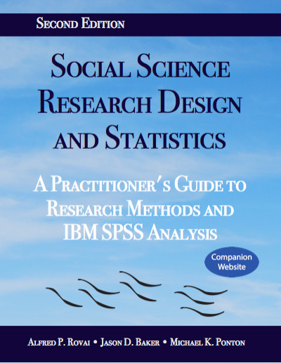
Social Science Research Design and Statistics, 2/e
Alfred P. Rovai, Jason D. Baker, and Michael K. Ponton
Creating a Histogram Using
Legacy Dialogs
PowerPoint Prepared by
Alfred P. Rovai
IBM® SPSS® Screen Prints Courtesy of International Business Machines Corporation,
© International Business Machines Corporation.

Slide 2
Creating a Histogram Using Legacy Dialogs
A histogram is an example of a frequency curve that depicts a univariate dataset. It is constructed by dividing the range of continuous data into equal-sized adjacent bins. For each bin, a rectangle is constructed with an area proportional to the number of observations falling into that bin.
Bins are plotted on the x-axis and frequencies (the number of cases accumulated in each bin) are plotted on the y-axis.
Histograms are similar to bar charts. However, with bar charts, each column represents a group defined by a categorical variable. In contrast, with histograms, each column represents a group defined by a continuous variable. Typically, there are no spaces between columns in a histogram while bar charts include spaces.
Histograms are useful in evaluating:
  The shape of a distribution
  Symmetry, skewness, and kurtosis
  Modality
  Presence of outliers

Slide 3
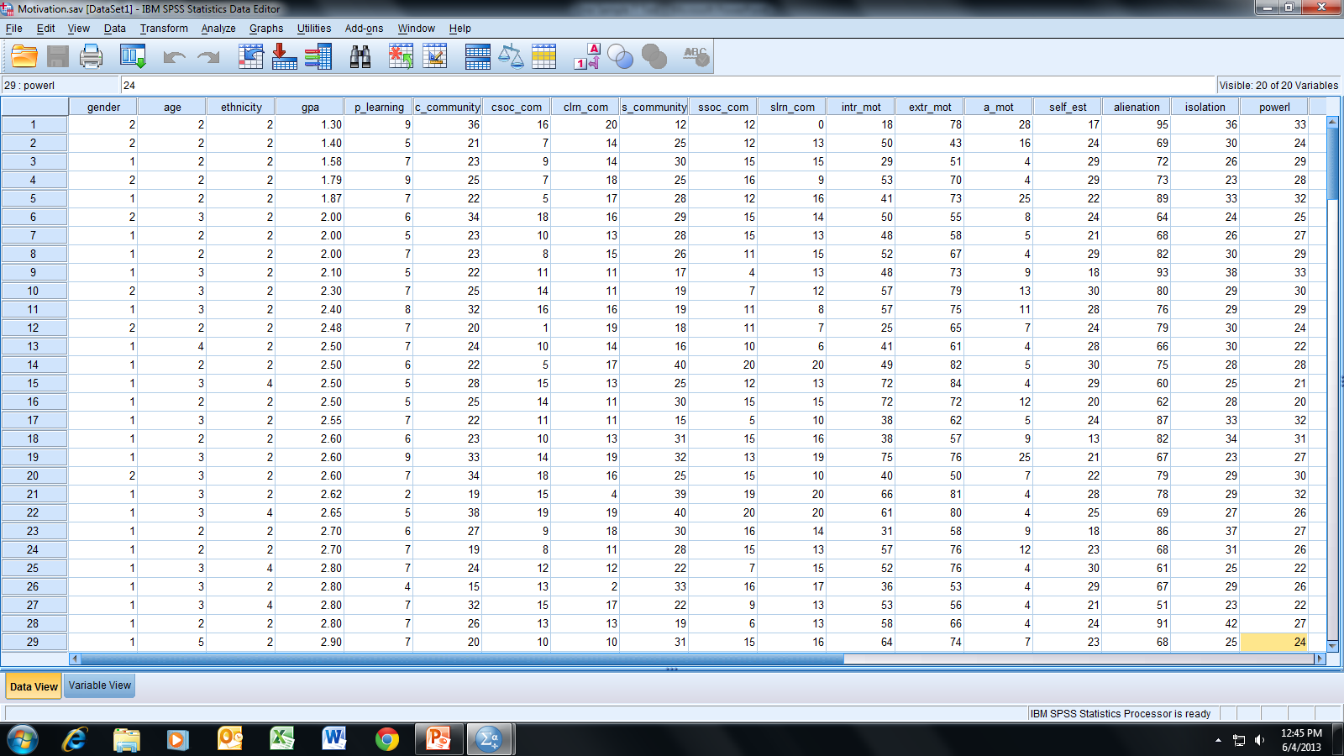
Open the dataset Motivation.sav.
File available at http://www.watertreepress.com/stats
TASK
Create a histogram of alienation with a normal curve overlay using Legacy Dialogs.*
Note: *Alternatively, SPSS Chart Builder can be used.

Slide 4
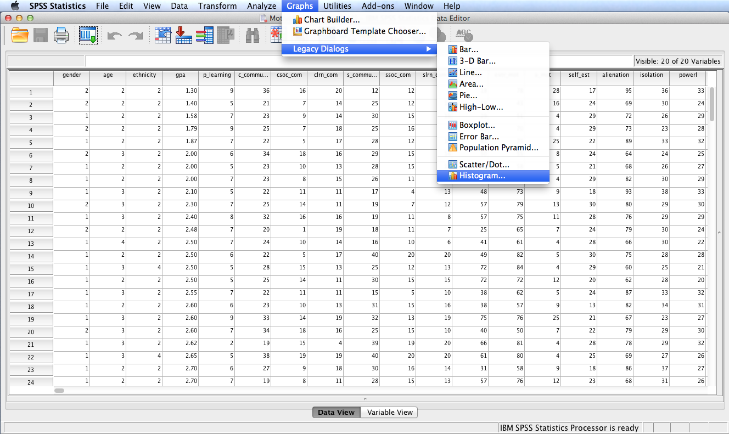
Follow the menu as indicated.

Slide 5
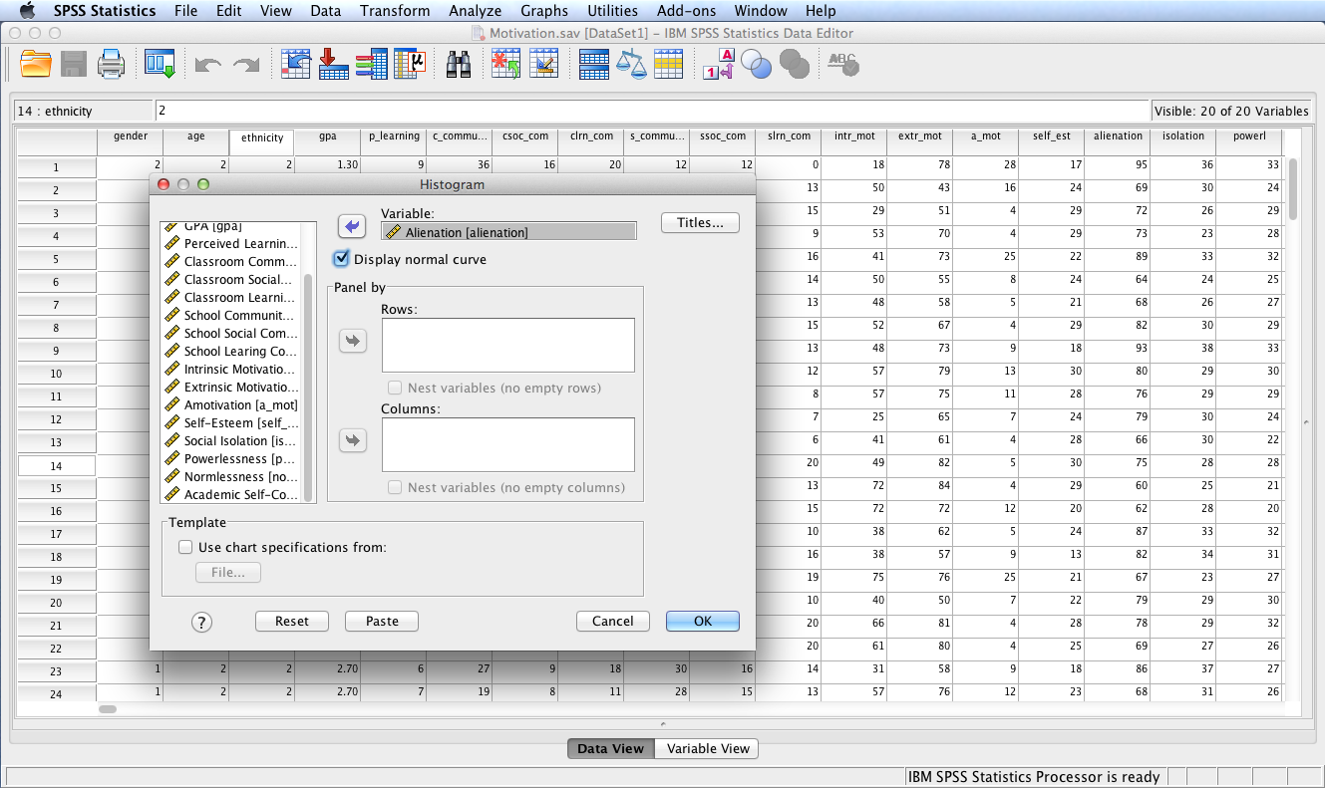
Move variable Alienation to the Variable: box. Check the Display normal curve box and
click OK.

Slide 6
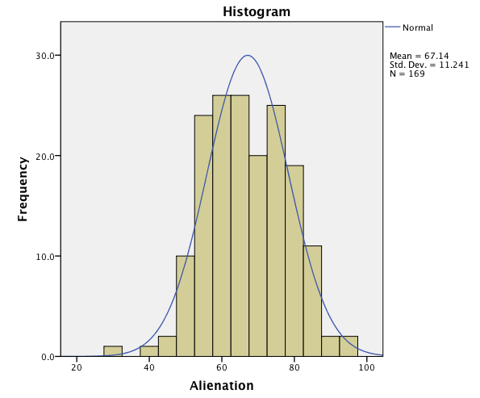
SPSS Output
The constructed histogram is displayed in the SPSS output window.
To copy the graph, click on it to highlight it and select Copy from the SPSS Edit menu. You can now paste the histogram in a word processing document.
The Chart Editor can be used to change the appearance of the histogram. Simply double click the chart in the SPSS Output window to launch the Chart Editor.

Slide 7
End of Presentation

